Slide 1







Enterprise Blockchain Developers (Intermediate)
In support of
Powered By

Slide 2
Outline
HyperLedger Family
What is HyperLedger
The Architecture
Architeture Explanation
Network Demo
Docker Overview
Docker Compose Overview
Docker Demo
Network Composing Process
© 2017-2020 SmartMesh Foundation Pte. Ltd. | MeshBox Foundation Pte. Ltd.

Slide 3
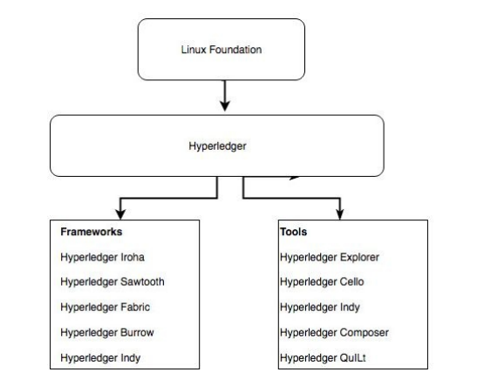
HyperLedger Family

Slide 4
What is HyperLedger
Hyperledger Iroha: Iroha, designed for mobile development projects, is based on Hyperledger Fabric and was contributed by Soramitsu, Hitachi, NTT Data, and Colu. It features modern, domain-driven C++ design as well as a new chain-based Byzantine fault tolerant consensus algorithm called Sumeragi.
Hyperledger Sawtooth: Sawtooth was contributed by Intel and includes a novel consensus algorithm that Intel came up with that's called Proof of Elapsed Time (PoET). PoET aims to achieve distributed consensus as efficiently as possible. Hyperledger Sawtooth has potential in many areas, with support for both permissioned and permissionless deployments and recognition of diverse requirements. Sawtooth is designed for versatility.
Hyperledger Burrow, which was contributed by Monax and Intel initially, is a modular blockchain that was client-built to the specification of the Ethereum Virtual Machine (EVM).

Slide 5
What is HyperLedger
Hyperledger Fabric, contributed by IBM, is designed to be a foundation for developing applications or solutions with a modular architecture. It allows for plug-and-play components, such as consensus and membership services, and leverages containers to host smart contracts called chaincode that comprise theapplication logic of the system.
Hyperledger Indy: Contributed initially by the Sovrin Foundation, Indy is a Hyperledger project made to support independent identity on distributed ledgers. Hyperledger Indy provides tools, libraries, and reusable components for providing digital identities rooted on blockchains.

Slide 6
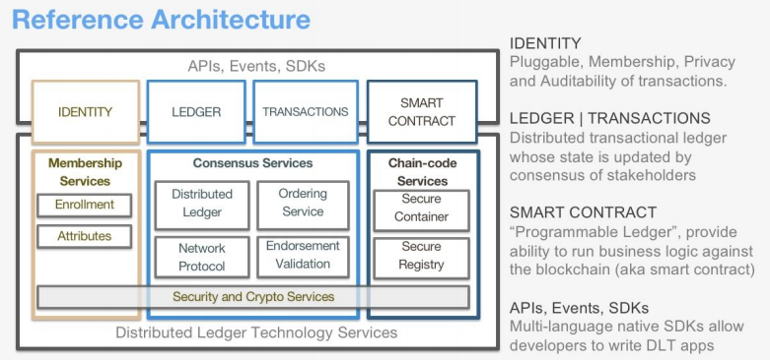
The Architecture

Slide 7
The Architecture
Membership services: This module is essentially a permissioning module and acts as a vehicle to establish a root of trust during network creation, but this is also instrumental in ensuring and managing the identity of members.
Transactions: A transaction is a request to the blockchain to execute a function on the ledger. The function is implemented by a chaincode.
Smart contract or chaincode services: Chaincode is an application-level code stored on the ledger as a part of a transaction.
Events: The process of validating peers and chaincodes can produce events on the network that applications may listen for and take actions on.
Consensus:In general, the consensus service enables digitally signed transactions to be proposed and validated by network members.
Ledger: data store. There are two options:
Level DB, Couch DB
Client SDK: A client SDK enables the creation of applications that deploy and invoke transactions atop a shared ledger.

Slide 8
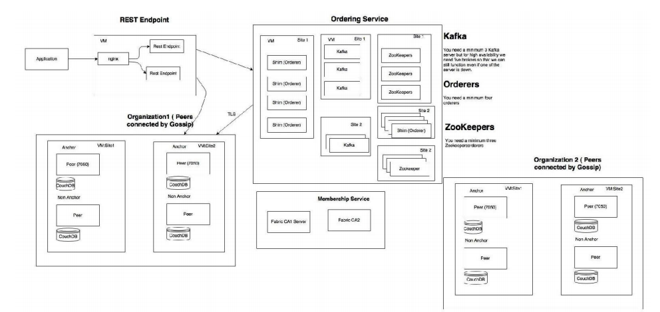
The Architecture

Slide 9
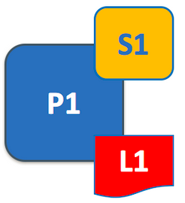
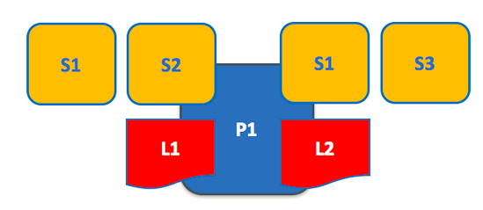
Architeture Explanation
Ledgers and Peers and Chain Code

Slide 10
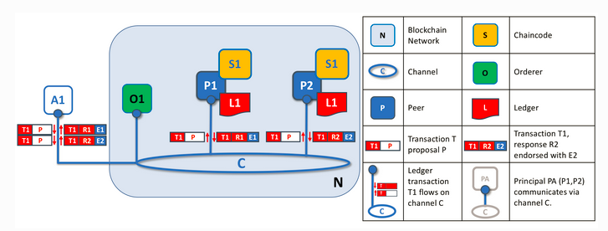
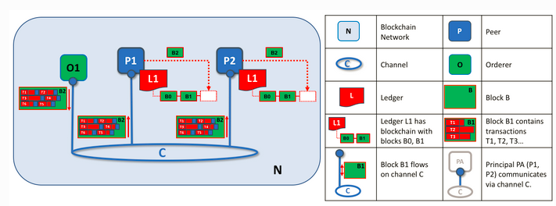
Architeture Explanation
Ordering and Transactions

Slide 11
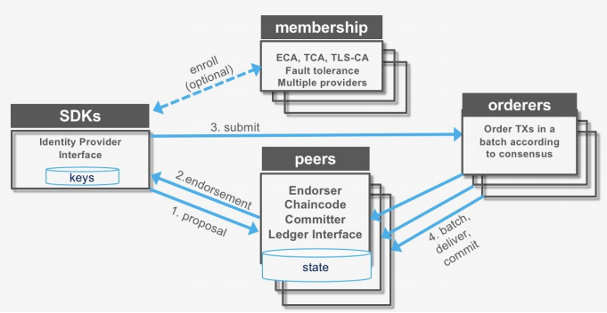
Architeture Explanation

Slide 12
Architeture Explanation
Transaction proposal (application SDK): 1. Transaction proposal is submitted by application SDK 2. It receives a transaction proposal response back (includes ReadWrite set) post endorsement 3. It submits the transaction (includes ReadWrite set) to the ordering service
Transaction endorsement: 1. The transaction is sent to the counter-parties represented by endorsing peers on their channel 2. Each peer executes the transaction by calling the specified chaincode function and signs the result, which becomes the read-write-set of the transaction 3. Each peer may participate in multiple channels, allowing concurrent execution
Transaction submitted to the ordering service: 1. The ordering service accepts endorsed transactions and orders them according to the plug-in consensus algorithm, and then delivers them on the channel 2. Peers on the channel receive transactions and validate before committing to the ledger
Transaction validation: 1. Validates each transaction and commit block 2. Validates the endorsement policy 3. Validates ReadSet versions in state DB 4. Commits the block to blockchain 5. Commits the valid transaction to state DB

Slide 13
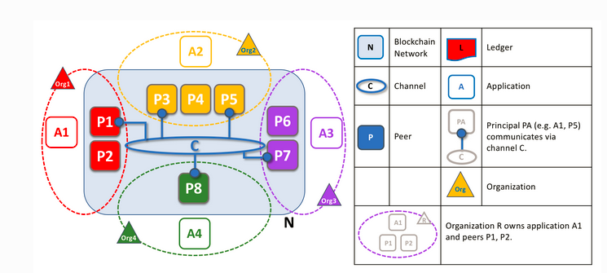
Architeture Explanation
Orgnaztions Peers, and Channels

Slide 14
Network Demo
https://hyperledger-fabric.readthedocs.io/en/release-2.2/test_network.html
git，cURL：
sudo apt install git
sudo apt install curl
Docker&Docker Compose
https://docs.docker.com/engine/install/ubuntu/
https://docs.docker.com/compose/install/
Pull the images
curl -sSL https://bit.ly/2ysbOFE | bash -s
sudo ./network.sh up
sudo docker ps (check the network component)

Slide 15
Docker Overview
What is Docker?
Docker is a tool designed to make it easier to create, deploy, and run applications by using containers.
Docker enables you to separate your applications from your infrastructure so you can deliver software quickly. With Docker, you can manage your infrastructure in the same ways you manage your applications
What does this mean?
mimic all the enviroment, systems in virtural container
the applications can run in this virtural envirement
this container with the application can be quickly deployed

Slide 16
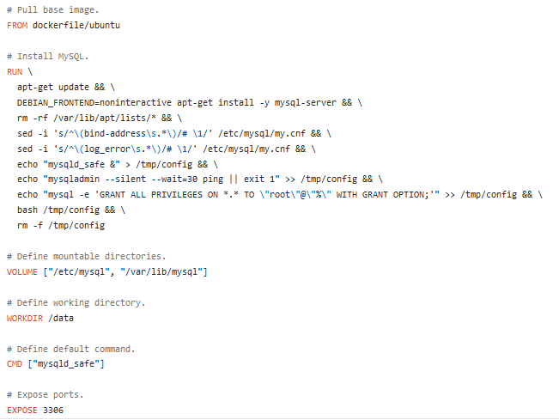
Docker File
Docker file
mysql Docker example: https://github.com/dockerfile/mysql/blob/master/Dockerfile

Slide 17
Docker Command Explain
FROM：initializes a new build stage and sets the Base Image for subsequent instructions.
RUN：instruction will execute any commands in a new layer on top of the current image and commit the results
COPY: copies new files or directories from <src> and adds them to the filesystem of the container at the path
CMD provide defaults for an executing container. CMD executed when docker run; RUN exectued when docker build。
ENTRYPOINT: allows you to configure a container that will run as an executable.
ENV: sets the environment variable <key> to the value <value>
VOLUME: creates a mount point with the specified name and marks it as holding externally mounted volumes from native host or other containers
EXPOSE: expose ports
WORKDIR: sets the working directory

Slide 18
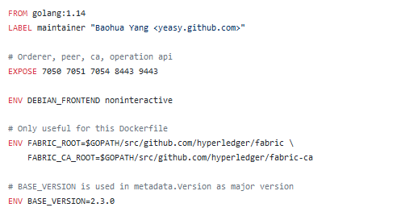
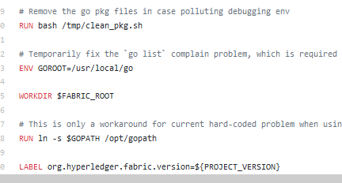
Docker File
Docker file
Fabric Docker example: https://github.com/yeasy/docker-hyperledger-fabric/blob/master/Dockerfile
https://github.com/docker-library/golang/blob/master/1.14/alpine3.12/Dockerfile

Slide 19
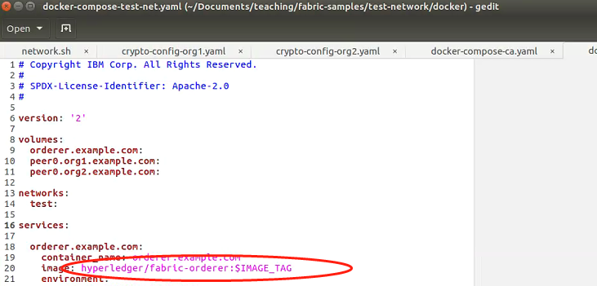
Docker Overview
https://github.com/yeasy/docker-hyperledger-fabric-orderer/blob/master/v2.3.0/Dockerfile

Slide 20
Docker Compose Overview
What is Docker Compose?
Compose is a tool for defining and running multi-container Docker applications. With Compose, you use a YAML file to configure your application’s services. Then, with a single command, you create and start all the services from your configuration.
Explain the test network docker-compose yaml file
https://github.com/hyperledger/fabric-samples/blob/master/test-network/docker/docker-compose-test-net.yaml
Docker set the enviriment and the applications, docker-compose quickly deploy in the servers
peer node start + all the envirment variable = command line peer node start

Slide 21
Docker Demo
Command Demo
Dockerizing a Node.js web app

Slide 22
Network Composing Process
1 Generating network cryptographic material
2 Generating channel artifacts
3 Composing a network
4 Creating a chaincode
5 Deploying the chaincode
6 Interacting with the chaincode

Slide 23
Network Composing Process
Code Demo
Explain network.sh
createOrgs
createConsortium
Explain createChannel.sh

Slide 24
Network Composing Process
1 Generating network cryptographic material
The first step in the configuration of a network involves the creation of certificates and signing keys for the MSP of each peer and orderer organization, and for TLS-based communication
important config file: crypto-config.yaml
cryptogen showtemplate >> crypto-config.yaml to get the template
Explain the generated teplate demostrate
corresponding config files in test network folder
test network -> organizations -> cryptogen
Explain the cryptogen in test network
sans the domain alternative name such as IP
template count and user count
EnableNodeOUs: further classify identities into clients and peers

Slide 25
Network Composing Process
2 Generating channel artifacts
To create a network according to an organization's structure, and to bootstrap a channel, we will need to generate the following artifacts:
A genesis block, containing organization-specific certificates that serve to initialize the Fabric blockchain.
Channel configuration information.
Anchor peer configurations for each organization. An anchor peer serves as a fulcrum within an organization, for cross-organization ledger syncing using the Fabric gossip protocol.
important config file: configtx.yaml (path defined by FABRIC_CFG_PATH)
configtx.yaml file to build the initial channel configuration that is stored in the genesis block
orgs section
capability section
applications section
orderer section
channel section

Slide 26
Network Composing Process
Organizations: Each organization is identified by an MSP ID and a channel MSP.
Capabilities: Fabric channels can be joined by orderer and peer nodes that are running different versions of Hyperledger Fabric. Channel capabilities allow organizations that are running different Fabric binaries to participate on the same channel by only enabling certain features.
Application: The application section defines the policies that govern how peer organizations can interact with application channels.
ImplicitMeta Policies: The ImplicitMeta policies in the Application section govern how peer organizations interact with the channel

Slide 27
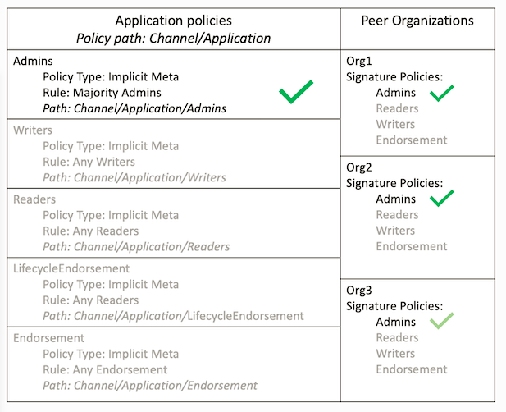
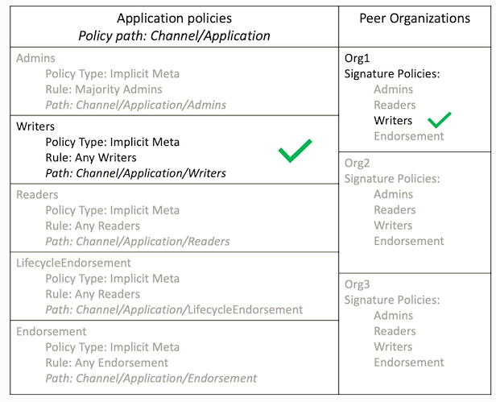
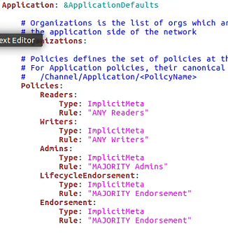
Network Composing Process

Slide 28
Network Composing Process
Order: Each channel configuration includes the orderer nodes in the channel consenter set
Channel: The channel section defines that policies that govern the highest level of the channel configuration
Profile: The configtxgen tool reads the channel profiles in the Profiles section to build a channel configuration
https://github.com/ksachdeva/hyperledger-fabric-example/blob/master/configtx.yaml

Slide 29
Network Composing Process
Create Channel
./network.sh createChannel -c channel1
Creating an application channel
create a channel creation transaction
configtxgen -profile TwoOrgsChannel -outputCreateChannelTx ./channel-artifacts/channel1.tx -channelID channel1
create the channel
peer channel create -o localhost:7050 --ordererTLSHostnameOverride orderer.example.com -c channel1 -f ./channel-artifacts/channel1.tx --outputBlock ./channel-artifacts/channel1.block --tls --cafile ${PWD}/organizations/ordererOrganizations/example.com/orderers/orderer.example.com/msp/tlscacerts/tlsca.example.com-cert.pem

Slide 30
Network Composing Process
Join the Org1 peer to the channel
peer channel join -b ./channel-artifacts/channel1.block
Join the Org1 peer to the channel
peer channel join -b ./channel-artifacts/channel_org2.block
update anchor peer 1
peer channel update -f channel-artifacts/config_update_in_envelope.pb -c channel1 -o localhost:7050 --ordererTLSHostnameOverride orderer.example.com --tls --cafile ${PWD}/organizations/ordererOrganizations/example.com/orderers/orderer.example.com/msp/tlscacerts/tlsca.example.com-cert.pem
update anchor peer 2

